Slide 1
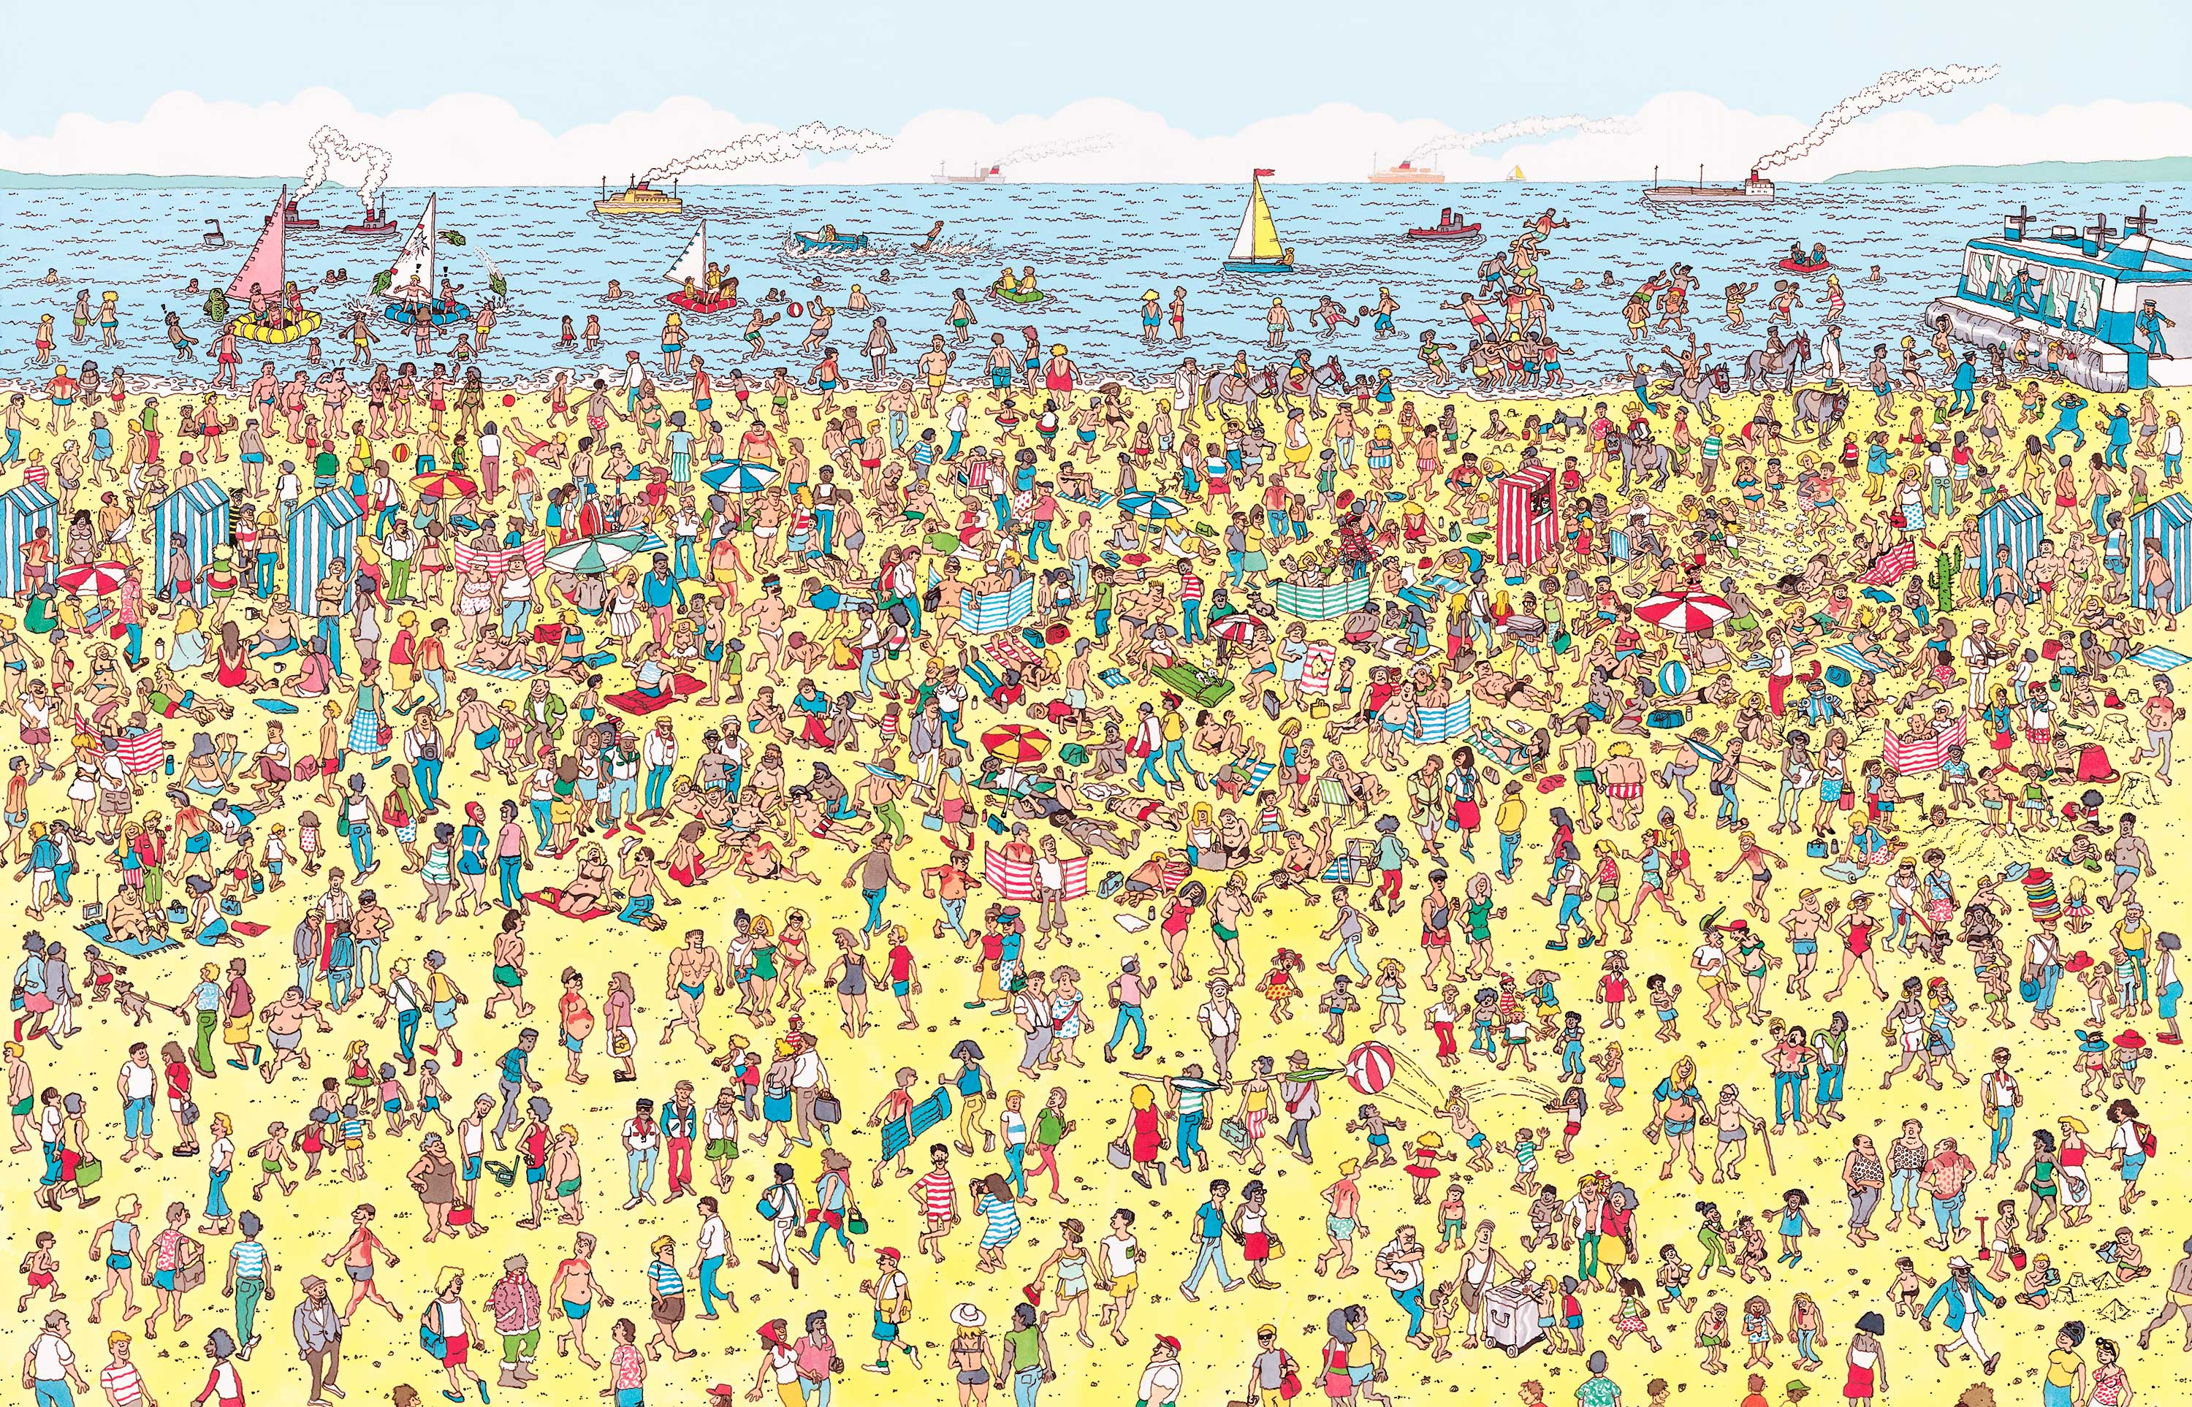
You should know the drill by now
Please Log in using your student ID
We will start at 5 past start time
Send me student ID in private chat
Apparently, Wally is hiding in this picture
!!!DO NOT SPOIL THIS FOR OTHERS!!!

Slide 2
I’ve been talking a lot about being social
What have you been up to outside of work or uni ?
What have you found out new about IT ?
Can you relate the two ?

Slide 3
Quiz 2
It is due on this Friday
Worth 4%
Should be similar to Quiz 1 while covering extra content
“After researching the questions and going through the theory I could figure out the answers”

Slide 4
Week 6
Graphs
Revision
Graph Representations
Prim, Kruskal & Reverse Delete
DFS & BFT

